Slide 1
Amazon Data Center Blackwell Road
SEPTEMBER 16, 2022
Notes:
WANT LOGO BIGGER

Slide 2
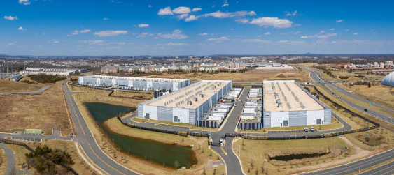
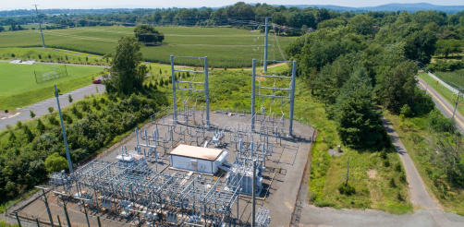
Overview
WHAT?
Amazon is seeking Warrenton Town Council’s permission to build a 220,000 square-foot data center
WHERE?
On a 42-acre tract adjacent to Country Chevrolet where Route 17 and Routes 15 & 29 converge
IS THAT ALL?
No, project approval would lead to electrical transmission lines across Fauquier County and an 8-acre substation
IF APPROVED, MORE DATA CENTERS ARE SURE TO FOLLOW!

Slide 3
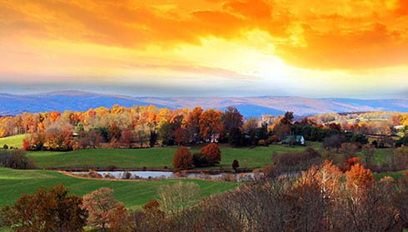
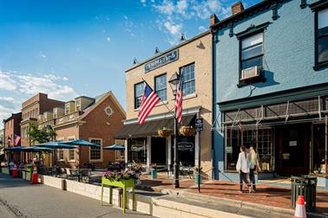
What We DO Know
Approval will permanently change Warrenton and Fauquier’s character
Significant noise and visual impacts will be felt across Warrenton and Fauquier County
The project is inconsistent with the town’s 2020 Comprehensive Plan
This is the most consequential land-use decision in the county in decades

Slide 4
What We DON’T Know
“the town does not have excess water to support industry and data centers…”
-Warrenton Town Engineer
Data center power requirements and line routing
Visual impacts of 50-foot-tall building on elevated gateway site
!
Approval of this incomplete application threatens to pave the way for a proliferation
of these facilities in Fauquier County
Noise study raises questions
Water requirements unclear
And what are the actual expected tax revenue and economic benefits?
Notes:
Wants to consolidate slide 4 over to slide 5
This was slide 9
Power Proposed substation and transmission lines: This SUP application lacks any information about the substation or transmission line impacts. The Commission should continue to challenge the premise asserted by the Applicant that the substation application is a separate proposal from that of the data center.
Water Requirements – Unclear but the Town Engineer stated “that the town does not have excess water to support industry and data centers…”
Noise The noise study that the Applicant has promised to provide will likely not include periodic generator testing procedures or the continuous buzzing of the substation. We ask that the Commission consider these associated noise impacts that are very much tied to the SUP application, even if the Applicant or provided studies do not account for them.
Realistic Elevations Rating the visual impact of the proposal are still needed. We ask that the Commission consider the potential visual impacts that could result directly or indirectly from the proposal including, the full height of the structure inclusive of mechanical equipment, the potential for requests for increased height (as we have seen in other proposals in the region), and the on-site substation on which the proposed data center depends.
Security fencing and facility lighting impacts The Applicant has indicated that there will be lighting both on the proposed data center building and around the fencing perimeter. Because the site is on a higher elevation than the surrounding area, lighting on the building’s perimeter fencing could be very visible along roadways and could impact adjacent properties. We ask that a comprehensive study of these light impacts, especially on nearby residential communities, be conducted to address this issue

Slide 5
Warrenton’s 2040 Comprehensive Plan
“A guiding document for future decisions regarding development, preservation, public facilities and other key components of community life”
Notes:
Use quote instead

Slide 6
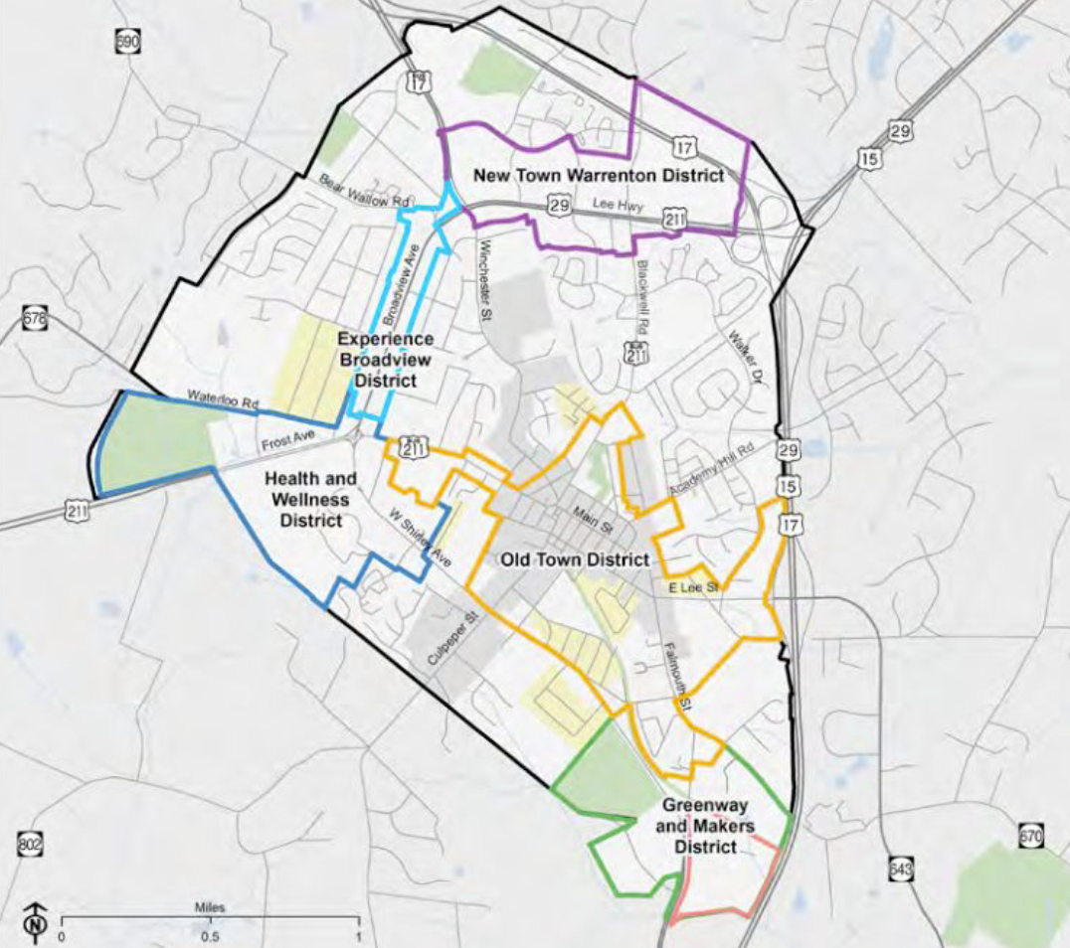
New Town Warrenton
District
In the comprehensive plan, the now proposed data center site was planned to be a “New Town District” with plans to prioritize the space as a major economic development opportunity including:
Housing
Jobs
Retail and commercial
Amenities
data center?
Are we really better off with this data center?

Slide 7
Is a data center the best use for this location?
PROS
Tax revenues (unclear how much)
Fifty jobs (probably fewer and low-paying)
CONS
Ignores Warrenton’s 2040 Comprehensive Plan
Results in electrical transmission towers littering county
Major noise and viewshed impacts
Missed opportunity for economic development
Opens the door to more data centers in town and across Fauquier County and conversion of farmland to utility-scale solar
Notes:
Would destroy the viewshed at the town’s northeast gateway and would be visible from numerous areas of the town
Major neighborhood impacts from the incessant noise
Completely inconsistent with Warrenton’s 2040 Comprehensive Plan
Would destroy the viewshed at the town’s northeast gateway and would be visible from numerous areas of the town
Would result in electrical transmission towers along highways leading into town and across the county
Major neighborhood impacts from the incessant noise
Missed opportunity for economic development on a prime parcel designated for mixed use in the comp plan
Would open the door to more data centers in town and across Fauquier County
There’s no question

Slide 8
Why not stick to the plan that was prepared with significant public input?

Slide 9
SUP Specific Evaluation Criteria
Town Council will soon face a decision that will dramatically change the character of Warrenton and Fauquier County forever.
Decisions as fundamental as this one should be made with more information, more planning, more transparency and more public input.
Consistency with comprehensive plan
Level and impact of any noise
Glare or light that may be generated
Compatibility of proposed land use with nearby existing or proposed uses
Adequacy of existing or proposed landscaping, screening and buffering and essential public facilities, services and utilities
Notes:
Want to use icons that indicate what we didn’t know

Slide 10
What’s at stake if the SUP is approved?
Scenic views entering and across town
Quiet neighborhoods and water supply
Rural town qualities and surrounding farmland
Opportunities for real economic potential
Transparency and accountability of elected officials

Slide 11
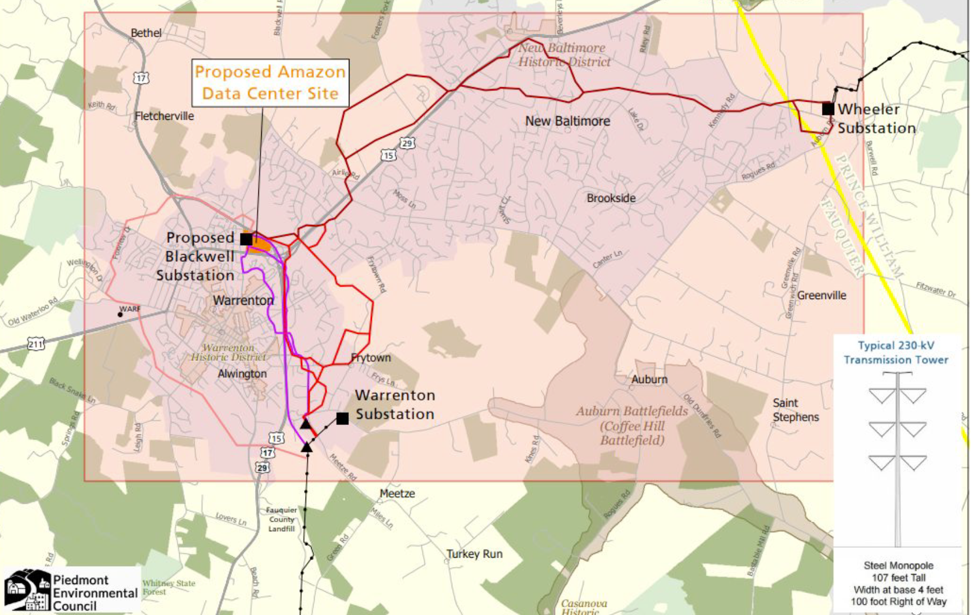
What About the Power Towers?
Dominion Energy has proposed building 230kV transmission lines and an 8-acre substation to supply the data center
This is approximately 20 times the power Amazon would need
Routing of the transmission lines is unclear
Transmission lines would require 110-foot towers and a 100-foot swath through countryside
Dominion has recently indicated they might be able to supply data center with out the transmission lines

Slide 12
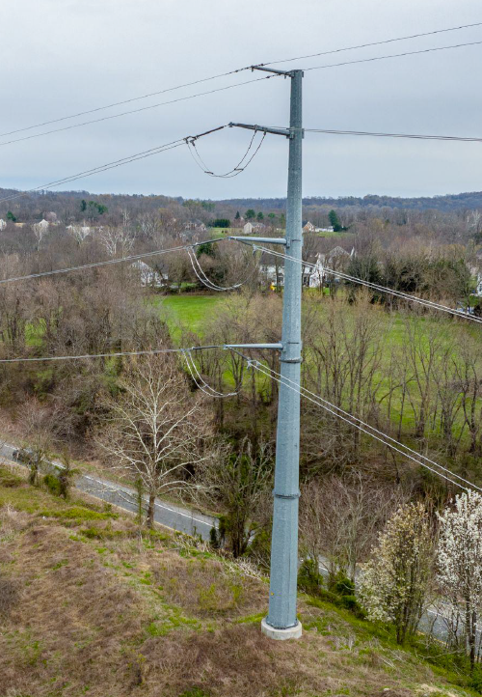
Power Towers: 3 Things to Know
SUP approval does NOT require final determination of power tower route
The route will be determined by Virginia’s State Corporation Commission (SCC). They have the final say
SCC almost never approves underground lines – this is NOT a likely option

Slide 13
Welcome to Warrenton!!! This is How the Power Towers Would Look on Route 29.
Notes:
This is how the power towers along 29 would look. A drone took footage from the power tower height, but I don’t know if it’s at 100 or 120 ft, and we don’t know how tall they’ll be but at least 100 ft, and then a graphic artist drew in the towers. So it’s meant to be a pretty accurate portrayal of the power towers.

Slide 14
A Changing Viewscape
Visible from many parts of the town and county with eight neighborhoods directly impacted:
Breezewood
Edgemont
Highlands
North Rock
Oak Springs
Reserve at Moorehead
Ridges of Warrenton
Villas at the Ridges

Slide 15
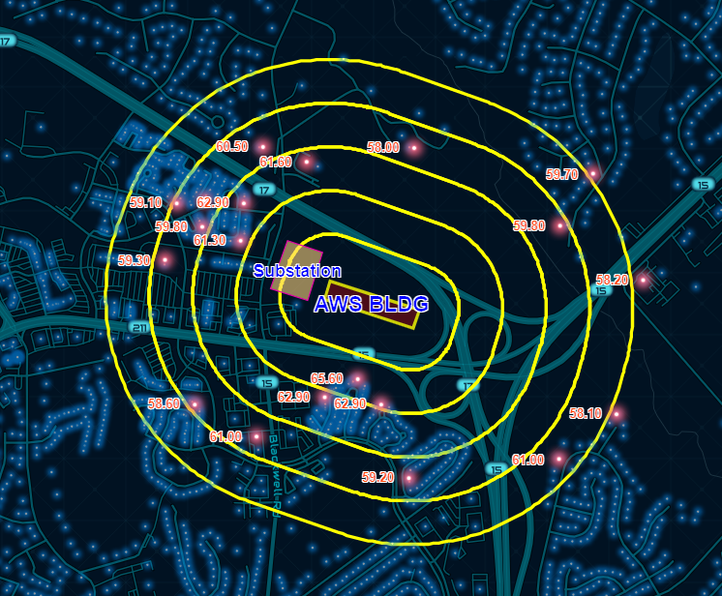
Noise in the Neighborhoods!
Data center facilities generate significant noise and vibration
Noisy on-site backup generators are run regularly to ensure operational status
657 homes and businesses within 2,500 feet of data center impacted
Documented health consequences
Projected noise levels from AWS and independent experts already exceed Warrenton Town limits.

Slide 16
How to Help: Say NO to the SUP
Contact the Planning Commission and Town Council
Sign the petition on Protect Fauquier’s website.
Tell your neighbors
Follow us on social media and share our updates with your friends
Attend and speak at upcoming meetings
September
October

Slide 17
Additional Resources
STOP Amazon, STOP Dominion Talking Points and Flyer
www.citizensforfauquier.org
www.pecva.org
www.protectfauquier.com

